Slide 1





Day 2: Advanced Database Design & Optimization
Sean Wong
2025/08/04

Slide 2
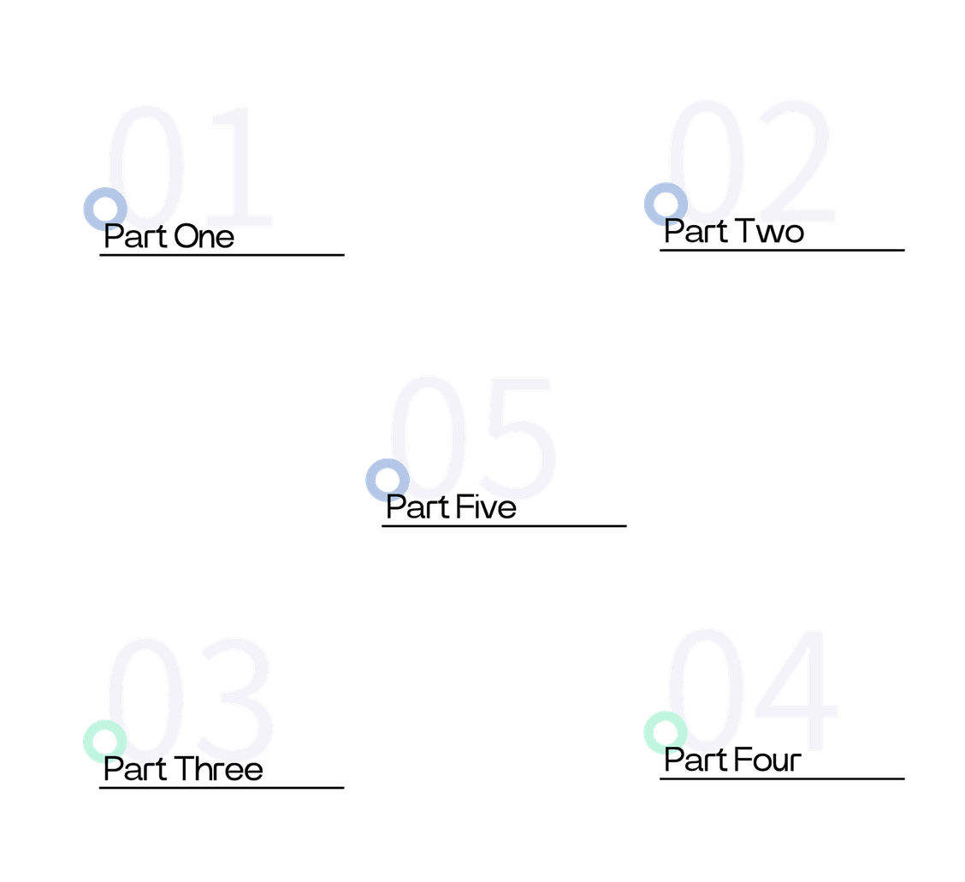

CONTENTS
Advanced Normalization
Indexing & Query Optimization
ACID Transactions
NoSQL Landscape
Design Best Practices

Slide 3

Advanced Normalization

Slide 4





Prevent Update Anomalies
By structuring data properly, normalization prevents update anomalies. This means that changes to the data are consistent and do not lead to errors or inconsistencies.
Enhance Query Performance
Eliminate Redundancy
A well-normalized database can improve query performance by reducing the amount of data that needs to be scanned and processed, leading to faster response times.
Normalization helps remove redundant data, ensuring that each piece of information is stored only once. This reduces storage requirements and improves data integrity.
Why Normalize Further?

Slide 5

Mastering BCNF Rules
Definition of BCNF
BCNF (Boyce-Codd Normal Form) requires that every determinant in a table must be a candidate key. This stricter form of normalization ensures that all dependencies are properly enforced.
Benefits of BCNF
BCNF eliminates anomalies that can occur in 3NF. By ensuring that every determinant is a candidate key, BCNF provides a higher level of data consistency and integrity.

Slide 6

Introduction to 4NF
4NF (Fourth Normal Form) focuses on eliminating multi-valued dependencies. This means that a table should not contain multiple sets of independent attributes.
Eliminating Multi-valued Dependencies
Solution: Decomposition
Identifying Violations
To achieve 4NF, decompose the table into smaller tables. This removes multi-valued dependencies and ensures that each table contains only one set of related attributes.
A table violates 4NF if it contains multiple independent sets of attributes for the same entity. This can lead to redundancy and inconsistencies.
Example Scenario
Consider a table storing employee skills and languages. Decomposing this table into separate tables for skills and languages eliminates redundancy and improves data integrity.

Slide 7

Achieving Fifth Normal Form
Definition and Importance of 5NF
5NF (Fifth Normal Form) eliminates join dependencies. It ensures that data can be reconstructed from smaller tables without loss of information, maintaining data integrity and consistency.

Slide 8

Normalization Ladder Recap
Normalization Steps
Practical Application
Normalization progresses through several forms: 1NF removes repeating groups, 2NF eliminates partial dependencies, 3NF removes transitive dependencies, BCNF ensures determinants are candidate keys, 4NF eliminates multi-valued dependencies, and 5NF removes join dependencies.
Each normalization form builds on the previous one, providing a systematic approach to designing efficient and consistent database schemas.

Slide 9
Indexing & Query Optimization

Slide 10

Index Fundamentals Explained
Types of Indexes
Indexes come in various types, including primary, unique, composite, and full-text indexes. Each type serves specific use cases and query patterns.
What is an Index?
An index is a data structure that improves query speed by allowing quick lookups. It maps key values to row locators, speeding up search operations.
Trade-offs of Indexing
While indexes speed up SELECT queries, they can slow down INSERT, UPDATE, and DELETE operations. They also require additional storage space.

Slide 11



Primary Index
Unique Index
A primary index is a unique index on the primary key. It ensures data uniqueness and provides fast access to records.
A unique index ensures that all values in a column are unique. It is useful for enforcing uniqueness constraints.
Composite Index
Full-Text Index
Choosing Optimal Index Types
A composite index is created on multiple columns. It is useful for queries that filter on multiple columns simultaneously.
A full-text index is used for text searching. It allows efficient searching of large text fields, such as in document-based databases.

Slide 12

Understanding Execution Plans
Execution plans provide a visual representation of how the database executes queries. They help identify bottlenecks and optimize performance.
Optimizing Queries
Use tools like EXPLAIN to analyze query execution plans. Ensure proper use of indexes, avoid SELECT *, and optimize JOINs and WHERE clauses for better performance.
Query Execution Plans

Slide 13

Balancing Index Trade-offs
Advantages and Disadvantages
Indexes offer faster query performance and efficient lookups but can slow down write operations and increase storage requirements. Balancing these trade-offs is crucial for optimal database performance.

Slide 14
ACID Transactions

Slide 15





Transaction Concepts Defined
What is a Transaction?
Importance of ACID
A transaction is a sequence of one or more operations executed as a single unit. It ensures that the database transitions from one consistent state to another.
ACID properties (Atomicity, Consistency, Isolation, Durability) ensure that transactions are processed reliably and maintain data integrity.

Slide 16
02
03
Consistency
Isolation
Consistency guarantees that the database remains in a valid state before and after the transaction. It enforces business rules and constraints.
Isolation ensures that concurrent transactions do not interfere with each other. It maintains the integrity of each transaction.
04
01
Durability
Atomicity
Durability ensures that once a transaction is committed, its effects are permanent, even if the system crashes. This guarantees data persistence.
Atomicity ensures that all or none of the operations in a transaction are completed. This prevents partial updates and maintains data consistency.
Atomicity Consistency Isolation Durability

Slide 17




BEGIN TRANSACTION
The BEGIN TRANSACTION command starts a new transaction, marking the beginning of a sequence of operations.
COMMIT
SQL Transaction Commands
The COMMIT command saves all changes made during the transaction, making them permanent in the database.
ROLLBACK
The ROLLBACK command reverts all changes made during the transaction, restoring the database to its previous state.

Slide 18
NoSQL Landscape

Slide 19


NoSQL Categories Overview
Column-Family Stores
Document Stores
Column-family stores like Cassandra are designed for large-scale data storage and are optimized for read-heavy workloads.
Document stores like MongoDB store data in flexible JSON-like documents. They are ideal for unstructured or semi-structured data.
Key-Value Stores
Graph Databases
Key-value stores such as Redis provide fast lookups and are suitable for caching and storing simple data structures.
Graph databases like Neo4j are used for data with complex relationships, such as social networks and recommendation engines.

Slide 20



SQL Characteristics
SQL databases have a rigid schema, support ACID transactions, and are vertically scalable. They are suitable for complex queries and transactions.
NoSQL Characteristics
NoSQL databases are schema-less, optimized for horizontal scaling, and handle large volumes of unstructured data. They offer high performance and flexibility.
SQL versus NoSQL Compared

Slide 21
High-Velocity Data
Flexible Schema
Complex Data Structures
NoSQL is ideal for high-velocity data ingestion, such as real-time analytics and IoT data, where speed and scalability are critical.
NoSQL databases offer flexible schemas that can evolve quickly, making them suitable for applications with changing data requirements.
NoSQL is well-suited for applications with complex, evolving data structures, such as social networks and content management systems.
When to Adopt NoSQL

Slide 22
Design Best Practices

Slide 23


Core Design Principles
Scalability
Maintainability
Consistency
Design databases that can handle increased data volume and traffic. Plan for future growth to ensure the system remains efficient and responsive.
Keep the design simple and modular. Use clear naming conventions and document assumptions to make the database easier to maintain and update.
Ensure data consistency through constraints and validation rules. Use primary keys, foreign keys, and unique constraints to maintain data integrity.

Slide 24

Safeguarding Data Integrity
Use Constraints
Use primary keys, foreign keys, and unique constraints to enforce data integrity. Avoid NULL values when possible to ensure data completeness.
Normalization and Denormalization
Balance normalization for data consistency with denormalization for performance. Choose the appropriate level based on query patterns and data access requirements.

Slide 25

Performance Tuning Toolkit
Partitioning
Partition large tables into smaller, more manageable pieces to improve query performance and maintenance.
Denormalization
In some cases, denormalization can improve read performance by reducing the number of joins required for common queries.
Sharding
Distribute data across multiple servers to balance the load and improve performance. Sharding is particularly useful for very large datasets.
Index Optimization
Optimize indexes by choosing the right type and ensuring they are used effectively in queries. Regularly update statistics to maintain performance.

Slide 26






Practice Lab & Assessment
Lab Activity
Apply advanced normalization and indexing techniques to a real-world scenario. Optimize queries and ensure data integrity through constraints and transactions.

Slide 27



Sean Wong
2025/08/04

